Slide 1
Implement a deep-learning pipeline for the classification of pneumonia in X-ray images.
Alan Abraham,Asha Babu,Athira Chandran,Manoli Bhadeshiya,
Nickson K Johnson
05/07/2024, HTW Saar, Germany./ Neural and Cognitive Systems

Slide 2
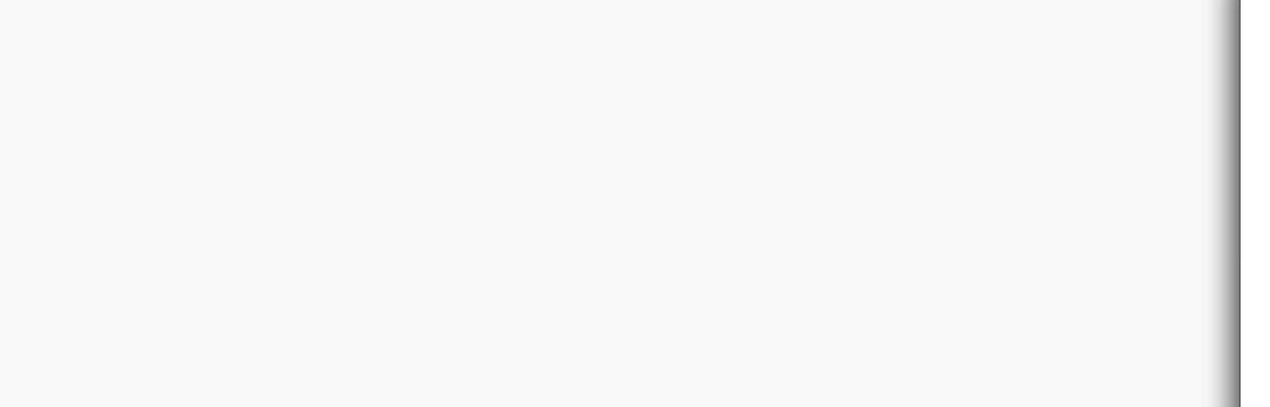


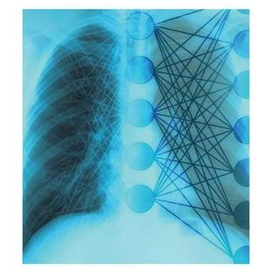
Pneumonia Classification With Deep Learning
PROBLEM:
Implement a deep-learning pipeline for the classification of pneumonia in X-ray images.
Introduction
Methods
Model
Results
Discussion
Future Work
References
fig.1 Xray image merged with CNN
05.07.2024
2

Slide 3
Pneumonia Classification With Deep Learning
CHALLENGES:
Challenges faced by conventional techniques are:
Interpretation of X-ray images can vary between radiologists due to differences in experience(subjectivity &Misleading)
Limited skilled radiologists especially in under-resourced area
Require significant time for image interpretation can delay treatment.
Medical images frequently experience issues like noise ,low resolution and inconsistent quality.
Introduction
Methods
Model
Results
Discussion
Future Work
References
05.07.2024
3

Slide 4
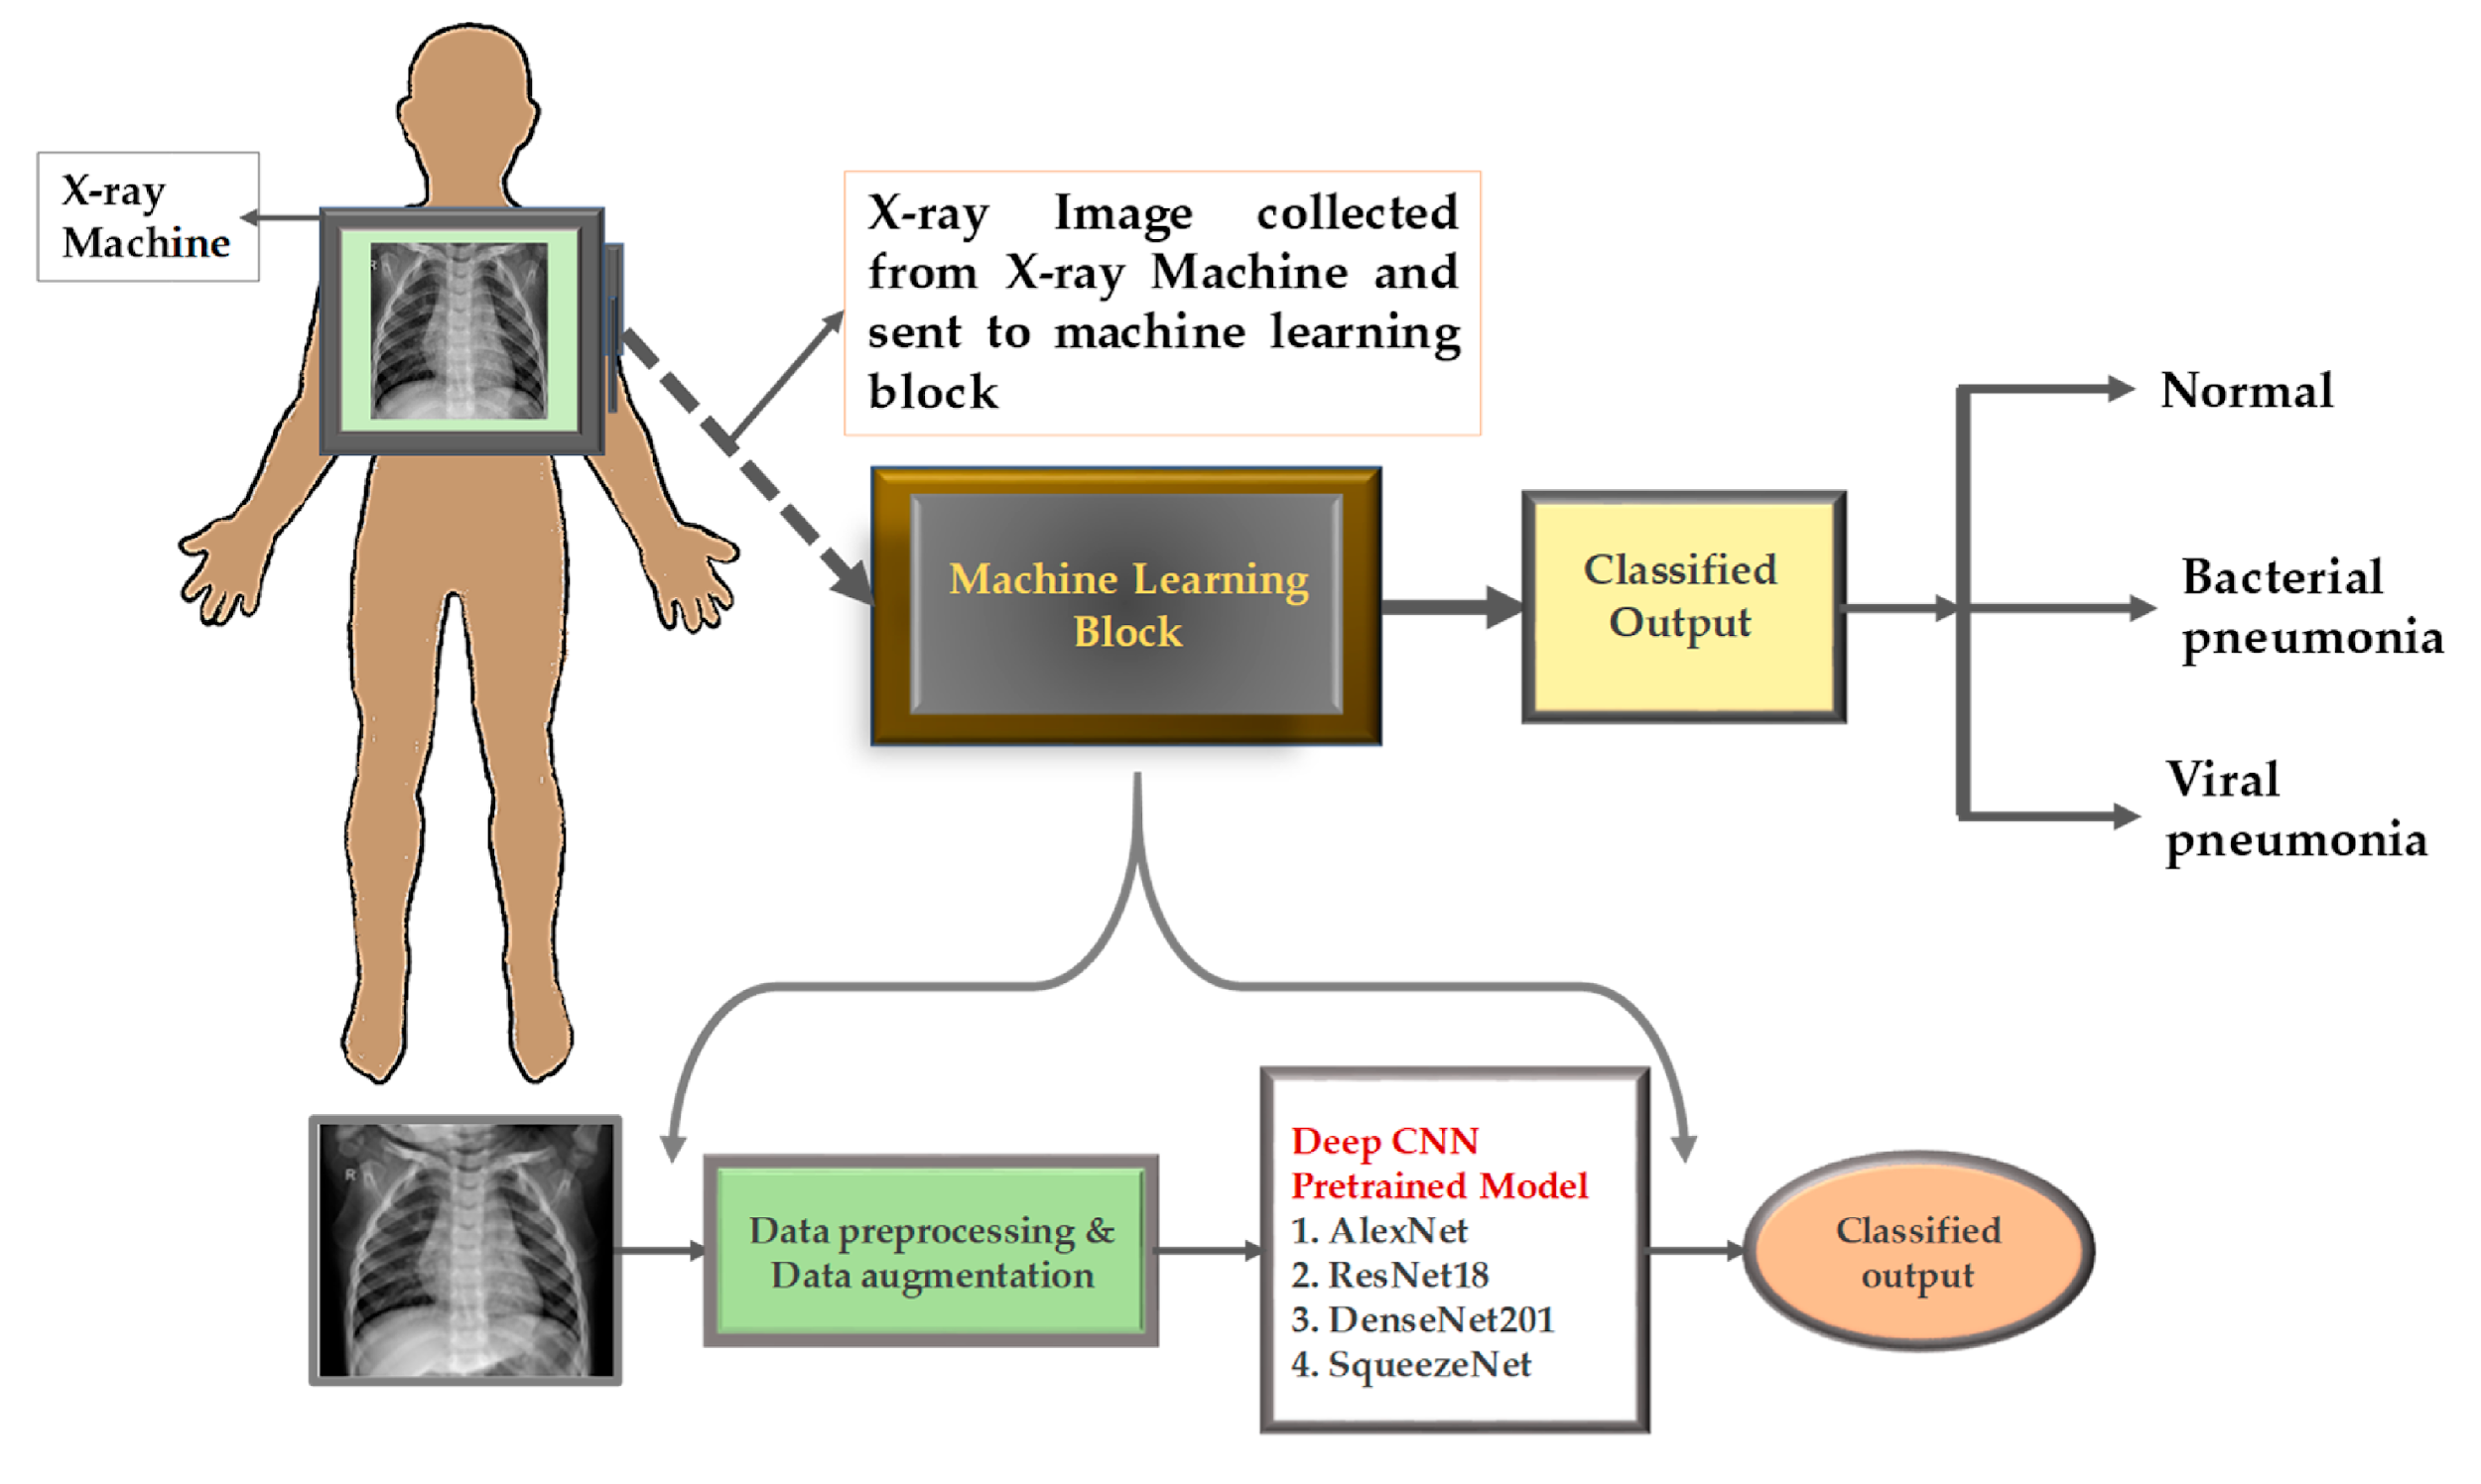
Solution
Reduce subjectivity and improve consistency
Once trained deep learning models can analyze X-rays quickly and accurately.
It analyses X-rays quickly, so patients get diagnosed faster.
By these key challenges deep learning provides a robust solution that enhances the accuracy, scalability, and efficiency of pneumonia diagnosis from chest X-ray
Introduction
Methods
Model
Results
Discussion
Future Work
References
fig.2. Block diagram of the system
05.07.2024
4

Slide 5
Dataset collection
Dataset
chest X-ray images for pneumonia classification
The data set is not balanced between Normal and Pneumonia classes
Image resolution: varied resolutions
Image extension: JPEG Format
Source: https://drive.google.com/drive/folders/1N9D68Uj6Y3R8_iYAE_dnP9J5BXUiDXRy?usp=sharing
Classes: Normal - Healthy lungs
    Pneumonia- Affected lungs
Introduction
Methods
Model
Results
Discussion
Future Work
References
05.07.2024
5

Slide 6
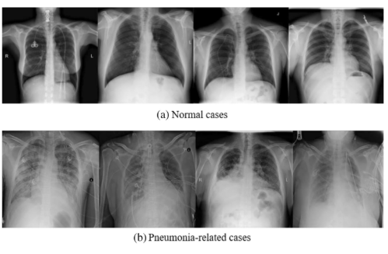
Normal and pneumonia images
Introduction
Methods
Model
Results
Discussion
Future Work
References
fig.3 .Xray images of (a) normal and (b) pneumonia cases
05.07.2024
6

Slide 7
Pipeline
Configuration File- Use .yaml file for configurations
Reproducibility -Use torch.manual_seed
Data Augmentation
Handling class imbalance
Advanced Preprocessing( Normalization and histogram Equalization)
Model Selection
Model Evaluation-Accuracy, Precision, Recall, F1-Score, AUC-ROC
K fold validation
Introduction
Methods
Model
Results
Discussion
Future Work
References
05.07.2024
7

Slide 8
Pipeline
Fine-Tuning and Optimization-Hyperparameter tuning process and techniques
Bootstrap aggregating
Model Checkpointing -Save best models (.pth)
Inference Pipeline - Build inference class/function
Introduction
Methods
Model
Results
Discussion
Future Work
References
05.07.2024
8

Slide 9
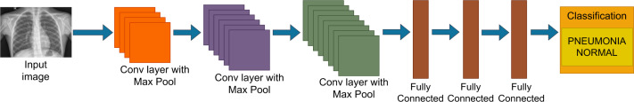
CNN Architecture
Introduction
Methods
Model
Results
Discussion
Future Work
References
fig.4. CNN Architecture
05.0.2024
9

Slide 10
Different models
VGG16 (Visual Geometry Group Network)
VGG16 is CNN known for its uniform architecture and deep structure.
16 weights layers (13 convolution layers and 3 fully connected layers).
Each block will be having max pooling layer of size 2x2 with stride of 2 .
Used for Image classification and image segmentation.
Activation Function: Linear function
Introduction
Methods
Model
Results
Discussion
Future Work
References
MobileNetV3:
Its CNN tuned to mobile phone CPUs.
Combination of hardware aware neural architecture search (NAS).
Layers depends on the specific configuration (Small or Large).
Good balance of speed and accuracy.
Activation Function: Linear and Sigmoid
05.07.2024
10

Slide 11
Different models
Introduction
Methods
Model
Results
Discussion
Future Work
References
ResNet-18 and 50:
ResNet (Residual Networks) is a deep convolutional neural network architecture that introduces residual connections to allow for the training of very deep networks by mitigating the vanishing gradient problem, making it easier to learn identity mappings.
Initial Convolution: 1 layer
Residual Blocks: 4 blocks x 2 layers/block x 4 sets of blocks = 16 layers
Final Fully Connected Layer: 1 layer.
Activation Function: Sequential linear and Sigmoid
05.07.2024
11

Slide 12
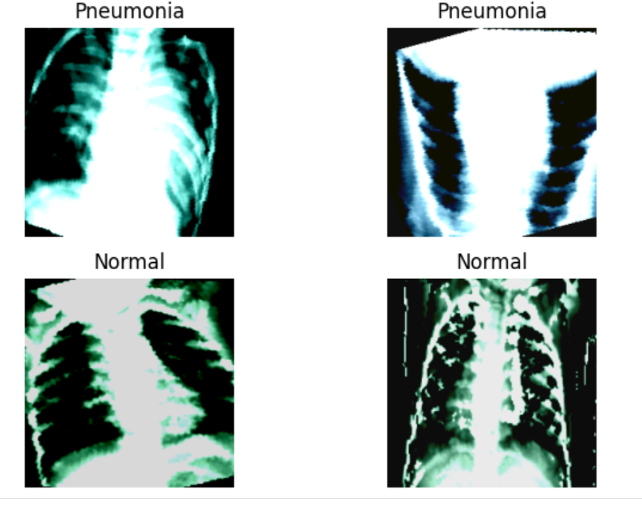
Data Augmentation
Introduction
Methods
Model
Results
Discussion
Future Work
References
fig1.5. Xray images after augmentation
05.07.2024
12

Slide 13
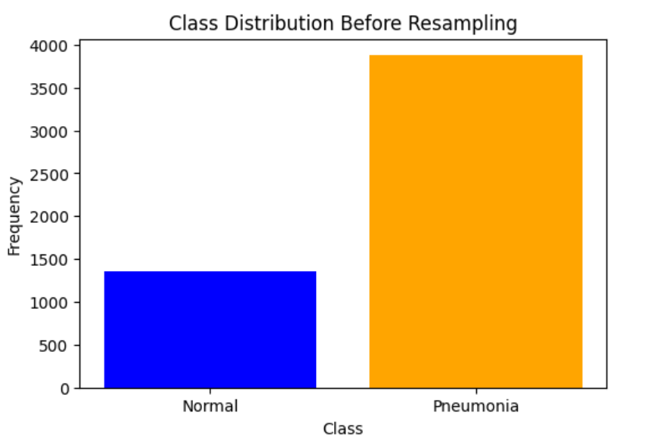
Distribution of datas without Oversampling
Introduction
Methods
Model
Results
Discussion
Future Work
References
fig.6. Class distribution before sampling
05.07.2024
13

Slide 14
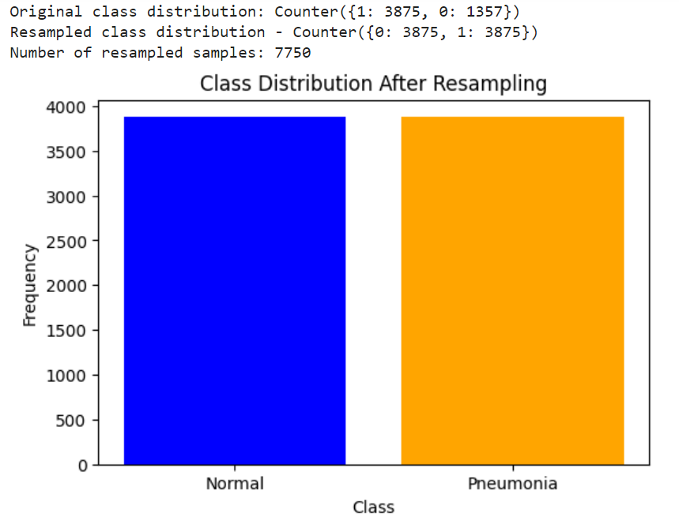
Distribution of oversampled datas
Introduction
Methods
Model
Results
Discussion
Future Work
References
fig.7. Class distribution after sampling
05.07.2024
14

Slide 15
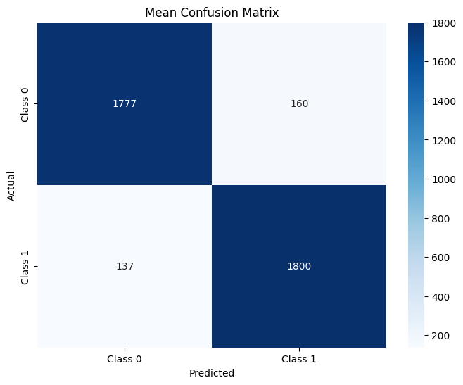
Confusion Matrix of VGG16
Introduction
Methods
Model
Results
Discussion
Future Work
References
fig.8. Confusion Matrix of VGG16
05.07.2024
15
Notes:
micro ampere/ cm^2

Slide 16
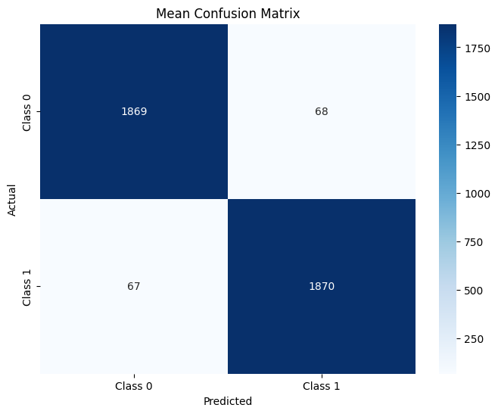
Confusion Matrix of ResNet50
Introduction
Methods
Model
Results
Discussion
Future Work
References
fig.9. Confusion Matrix of ResNet50
05.07.2024
16

Slide 17
Best Model
Best hyperparameters for fold 3: {'learning_rate': 0.001, 'num_epochs': 5}
VGG-16 Metrics: [0.92309677 0.92363955 0.92309677 0.92306797 0.9230568 ]
ResNet-50 Metrics: [0.96516129 0.96534196 0.96516129 0.96515872 0.96518388]
The best model is ResNet-50
ResNet-50 Metrics:
Accuracy: 0.9652
Precision: 0.9653
Recall: 0.9652
F1 Score: 0.9652
AUC-ROC: 0.9652
ResNet-50 Number of trainable parameters: 23512130
Running on device: cuda
ResNet-50 Parameters and Hardware Profile:
Number of trainable parameters: 23512130
Running on device: cuda
Introduction
Methods
Model
Results
Discussion
Future Work
References
05.07.2024
17

Slide 18
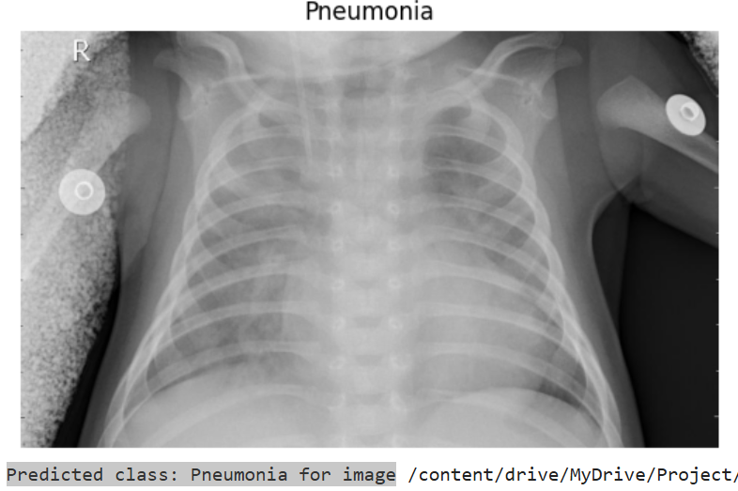
Inference
Introduction
Methods
Model
Results
Discussion
Future Work
References
fig.10. Inference prediction
05.07.2024
18

Slide 19
Comparison after k Fold cross validation and hypertuning
Models | MobilNetV3 | ResNet-18 | VGG16 | ResNet-50
Accuracy | 78.89 | 82.21 | 92.30 | 96.51
Precision | 70.76 | 86.16 | 92.34 | 96.51
Recall | 87.89 | 82.21 | 92.30 | 96.75
f1 Score | 76.87 | 80.55 | 92.34 | 96.54
AUC-ROC | 78.78 | 95.54 | 92.67 | 96.51
Introduction
Methods
Model
Results
Discussion
Future Work
References
table.1. Comparison of models after k Fold cross validation and hypertuning
05.07.2024
19

Slide 20
Discussion
ResNet 50 is the best model
Learning rate 0.001
Increasing epoch model becomes more accurate
More batch size more memory and less time
It is noted that GPU is more efficient than CPU
Introduction
Methods
Model
Results
Discussion
Future Work
References
05.07.2024
20

Slide 21
Future works
Increase epochs
Increase the number of fold
Collect more data to improve the model performance
Experiment with other deep learning techniques
Introduction
Methods
Model
Results
Discussion
Future Work
References
05.07.2024
21

Slide 22
Pneumonia Classification With Deep Learning
MobileNetV3 Explained | Papers With Code
VGG-16 | CNN model – GeeksforGeeks
https://www.kaggle.com/
https://jupyter.org/
https://colab.google/
NCS FINAL - Colab (google.com)
Introduction
Methods
Model
Results
Discussion
Future Work
References
05.07.2024
22

Slide 23
Thank you very much for your attention !
05.07.2024

